Slide 1
Module 1: Overview of problem solving
Unit 2: The problem solving process and the role of algorithm in the problem solving process
COS 102: INTRODUCTION TO PROBLEM SOLVING (3 UNITS)

Slide 2
Learning Objectives:
The problem solving process
Demonstrate knowledge of the problem solving process
Demonstrate understanding of the role of algorithm in the problem solving process
We can define problem solving as the act of getting a solution to a difficulty or constraint etc.. Then the steps followed in doing that is the process.
There are different ways we human approach problem in trying to get a solution to it.

Slide 3
Some of the ways human perceive and solve problems may include:
By a way of natural endowment ( i.e. We "just do it naturally")
Guesswork-and-luck
Trial-and-error
All the mentioned ways to which problems might be solved are not the focus when we talk about algorithm.
Those are ways which are not systematically effective (ways that are not reliable i.e. cannot be true for every instance). However those that are systematically effective are useful to everyone.

Slide 4
Examples of systematic ways of solving problems include:
Using a process model: A process model defines scientific steps to which a problem is solved. Algorithm has a role to play in a systematic way of solving problem such as the problem solving process model.
Experience: Someone else's blue print or instructions to solving particular problem. This is what algorithm is about.

Slide 5
Regardless of the area of study, computer science is all about solving problems with computers. The problems that we want to solve can come from any real-world problem or perhaps even from the abstract world.
We need to have a standard systematic approach to solving problems. Since we will be using computers to solve problems, it is important to first understand the computer’s information processing model shown in figure 1.

Slide 6
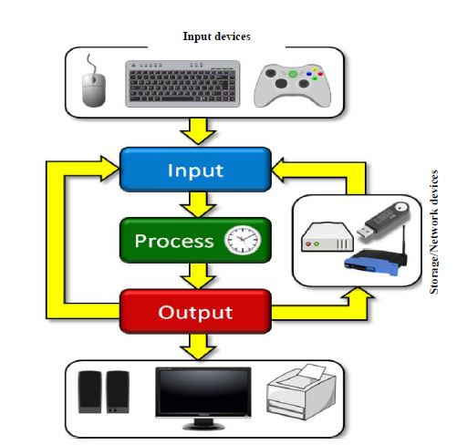
Figure 1 depicts a typical single Central Processing Unit (CPU) computer with input and output components
Problems are solved using a computer by obtaining some kind of user input via an input device (e.g., keyboard, mouse or game control)
Fig. 1: Computer’s information processing model

Slide 7
User inputs are processed to produce some output data (e.g., numbers, images, text, sound) via output devices (e.g. speaker, display unit, printers)
Input/output data may also be transmitted via storage drives and network devices.

Slide 8
In regards to problem solving, we will apply the computer as a model of computation in that we will assume we are given some kind of input information we need to work with in order to produce some desired output as solution.
Computer as a model of computation

Slide 9
In solving a problem, there are some well-defined steps to be followed. For example, consider how the input/process/output works on a simple problem:
1. Input: Get all the grades via the keyboard or by reading them from a USB flash drive or hard disk.
2. Process: Add them up and compute the average grade. This is a CPU function
Example: Calculate the average grade for all students in a class.
3. Output: Output the answer on the display unit, to the printer, or a combination of any of these devices.

Slide 10
UNDERSTANDING THE PROBLEM
FORMULATING A MODEL
DEVLOPING AN ALGORITHM
WRITING THE PROGRAM
TESTING THE PROGRAM
EVALUATING THE SOLUTION
The problem solving process

Slide 11
In what format is the data/information?
What is missing in the data provided?
Does the person solving the problem have everything needed?
What output information needs to be produced?
In what format should the result be: text, picture, graph?
What are the other requirements needed for computation?
Step 1: Understand the Problem
The first step to solving any problem is to make sure that one understands the problem about to be solved. One needs to know:
What input data/information is available?
What does the data/information represent?

Slide 12
Explanations on Step 1
If it is a number, the grade might be a whole integer like 73 or it may be a real number like 73.42. As such, it is important to understand the format of the grades in order to solve the problem properly.
Going back to our example with grades, it is understood that the input is a bunch of grades. But we need to understand the format of the grades.
Each grade might be a number from 0 to 100 or it may be a letter grade from A to F.

Slide 13
We also need to consider missing grades. What if we do not have the grade for every student: for instance, some were away during the test? Should we be able to include that person in our average (i.e., they received 0) or ignore them when computing the average?
We also need to understand what the output should be expected. Should the output be a whole or real number or a letter grade? Do we want to display a pie chart with the average grade? The choice is ours.

Slide 14
In the example given in step 1, the average of inputted grades is to be computed.
Step 2: Formulating a Model
The next step is to understand the processing part of the problem. Many problem are broken down into smaller problems that require some kind of simple mathematical computations in order to process the data.
A model (or formula) is thus needed for computing the average of the grades.
If there is no such “formula”, one must be developed.

Slide 15
Explanations on Step 2
𝐴𝑣𝑒𝑟𝑎𝑔𝑒1= (𝑥1+ 𝑥2+𝑥3+ ⋯+𝑥𝑛)/𝑛
In order to come up with a model, we need to fully understand the information available to us.
Where the result will be a number from 0 to 100. That is very straight forward.
Assuming that the input data is a bunch of integers or real numbers 𝑥1,𝑥2,⋯,𝑥𝑛 representing a grade percentage, the following computational model may apply:

Slide 16
However, this approach will not work if the input data is a set of letter grades like B-, C, A+, F, D-, etc., because addition and division cannot be performed on the letters.
After some thought, we may decide to assign an integer number to the grade letters as follows: 𝐴+=12, 𝐴 =11, 𝐴−=10, 𝐵+=9, 𝐵 =8, 𝐵−=7, 𝐶+= 6, 𝐶 =5, 𝐶− =4, 𝐷+=3, 𝐷 =2, 𝐷−=1 𝐹=0
This problem solving step must figure out a way to produce an average from such letters. Thinking is required.

Slide 17
If it is assumed that these newly assigned grade numbers are 𝑦1,𝑦2,⋯,𝑦𝑛, then the following computational model may be used:
As for the output, if it is to be represented as a percentage, then 𝐴𝑣𝑒𝑟𝑎𝑔𝑒1 can either be used directly or one may use (𝐴𝑣𝑒𝑟𝑎𝑔𝑒2/12), depending on the input that we had originally.
𝐴𝑣𝑒𝑟𝑎𝑔𝑒2= (𝑦1+ 𝑦2+𝑦3+ ⋯+𝑦𝑛)/𝑛
Where the result will be a number from 0 to 12.

Slide 18
If a letter grade is preferred as output, then one may need to use (𝐴𝑣𝑒𝑟𝑎𝑔𝑒1/100∗12) or (𝐴𝑣𝑒𝑟𝑎𝑔𝑒1∗0.12) or 𝐴𝑣𝑒𝑟𝑎𝑔𝑒2 and then map that to some kind of “lookup table” that allows one to look up a grade letter according to a number from 0 to 12.
The main point to understand this step of the problems solving process is that it is all about figuring out how to make use of the available data to compute an answer

Slide 19
Step 3: Develop an Algorithm
Two commonly used representations for an algorithm is pseudo-code, and flowcharts.
To develop an algorithm, the instructions must be represented in a way that is understandable to a person who is trying to figure out the steps involved.
Consider to represent our finding the average of grade problem in a pseudo-code.

Slide 20
Algorithm: DisplayGrades
Example 2:
Consider the following example for solving the problem of a broken lamp.
1. set the sum of the grade values to 0.
2. load all grades 𝑥1,𝑥2,⋯,𝑥𝑛 from file.
3. repeat n times {
4. get grade xi
5. add xi to the sum }
6. compute the average to be sum / n.
7. print the average
First is the example in a flowchart, and then in pseudo-code.

Slide 21
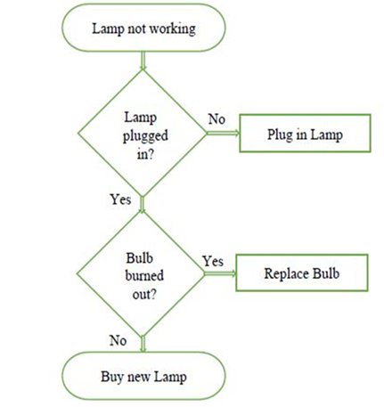
Flowchart
Pseudo-code
1. IF lamp works, go to step 7.
2. Check if lamp is plugged in.
3. IF not plugged in, plug in lamp.
4. Check if bulb is burnt out.
5. IF blub is burnt, replace bulb.
6. IF lamp doesn’t work buy new lamp.
7. Quit ... problem is solved.

Slide 22
Step 4: Writing the Computer Program
Code
int sum = 0;
byte[] x = loadBytes("numbers");
for (int i=0; i<x.length; i++)
sum = sum + x[i];
int avg = sum / x.length;
print(avg);
Consider to represent our finding the average of grade problem in a computer program.

Slide 23
Step 5: Test the Program
Running a program is the process of telling the computer to evaluate the compiled instructions. When a program is run and all is well, you should see the correct output.
Once a program is written and compiles, the next task is to make sure that it solves the problem that it was intended to solve and that the solutions are correct.
It is possible however, that a program works correctly for some set of input data but not for all.

Slide 24
If the output of a program is incorrect, it is possible that the algorithm was not properly converted into a proper program.
Perhaps some instructions are performed out of sequence. Whatever happened, such problems with the program are known as bugs.
It is also possible that the programmer did not produce a proper algorithm back in step 3 that handles all situations that could arise.

Slide 25
Step 6: Evaluating the Solution
It is often the case that it may be realised that the program solution does not solve the problem the way it is expected. It may also be realised that more steps are involved.
Once the program produces a result that seems correct, the original problem needs to be reconsidered to make sure that the answer is formatted into a proper solution to the problem.

Slide 26
There may be need to display the information in a way that helps visualize the results with respect to the problem; perhaps a chart or graph is needed.
For example, if the result of a program is a long list of numbers, but the intent was to determine a pattern in the numbers or to identify some feature from the data, then simply producing a list of numbers may not suffice.
It is also possible that when the results are examined, it is realised that additional data are needed to fully solve the problem.

Slide 27
Conclusion
It may be necessary to re-do some of the steps again, perhaps going as far back as step 1 again, if data were missing.
It is important to remember that the computer will only do what it is told to do. It is up to the problem solver to interpret the results in a meaningful way and determine whether or not it solves the original problem.

